Slide 1
YOUR ADMIN
SUB-MODULE: DISPATCH

Slide 2
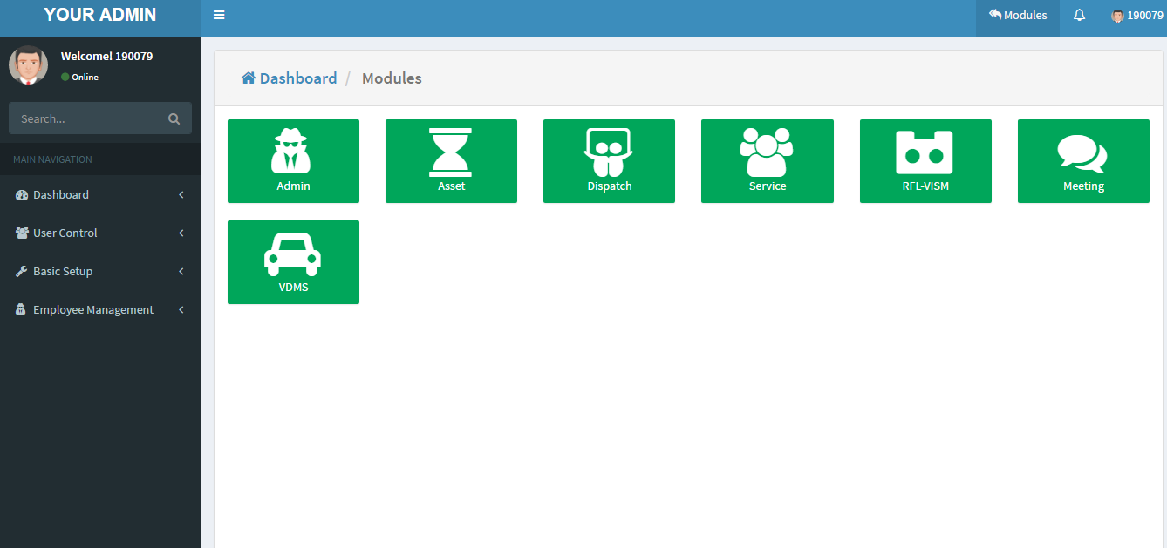
YOUR ADMIN HOME

Slide 3
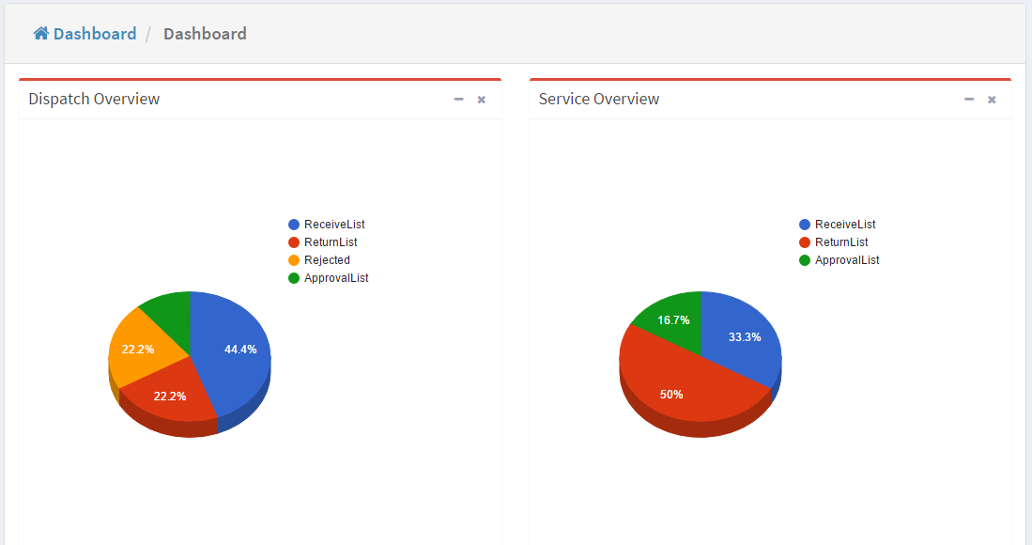
YOUR ADMIN DASHBOARD

Slide 4
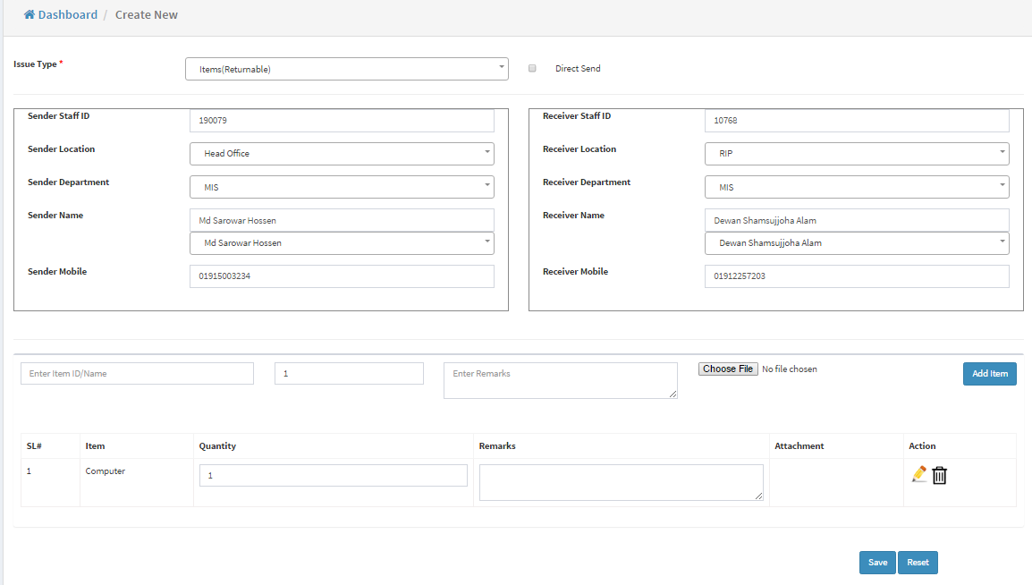
NEW DISPATCH

Slide 5
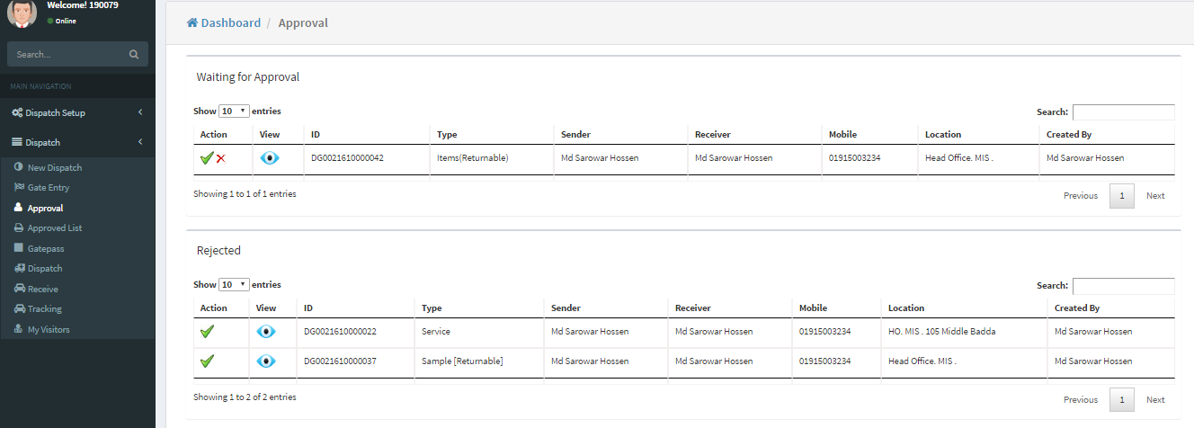
APPROVAL

Slide 6
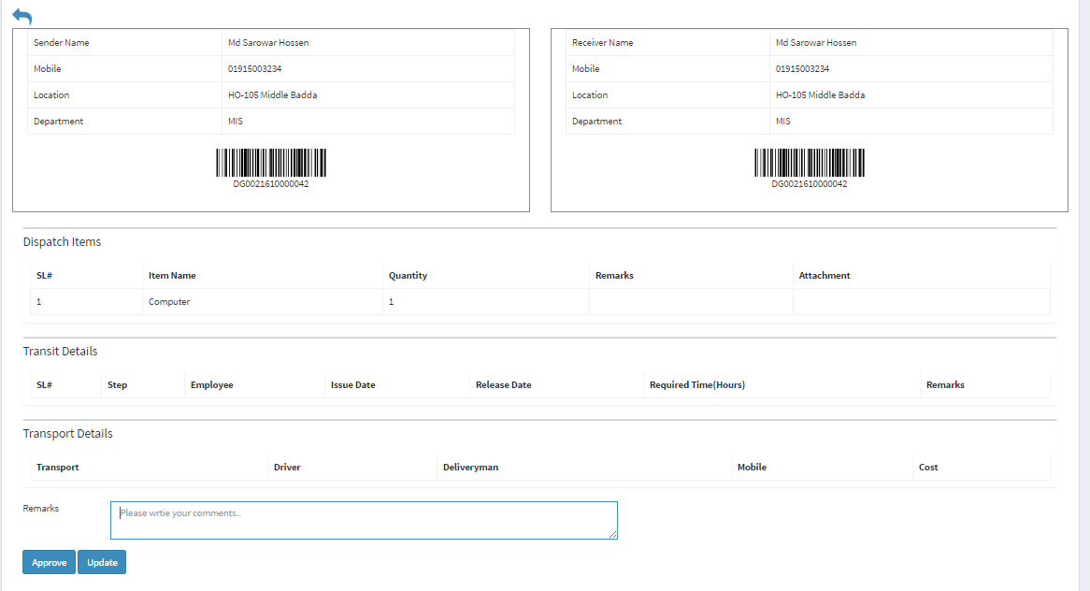
DETAILS VIEW

Slide 7
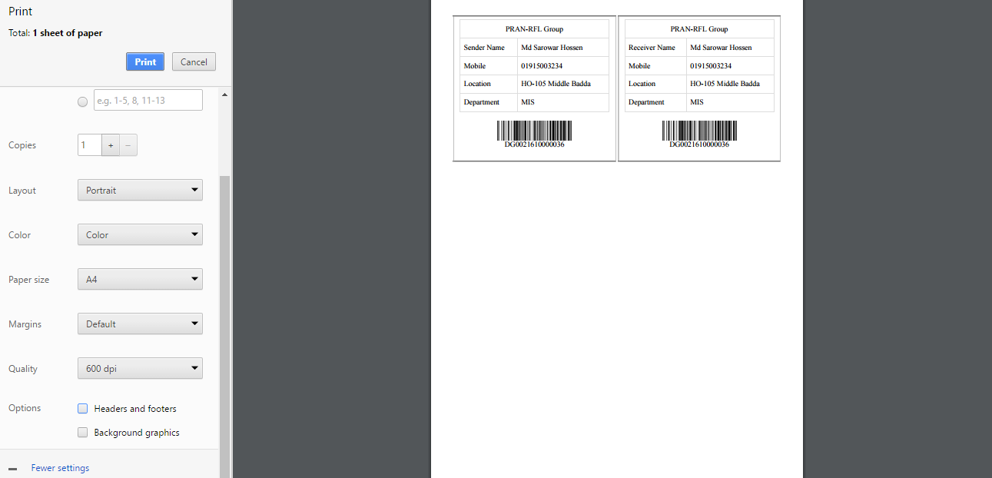
PRINT LABEL

Slide 8
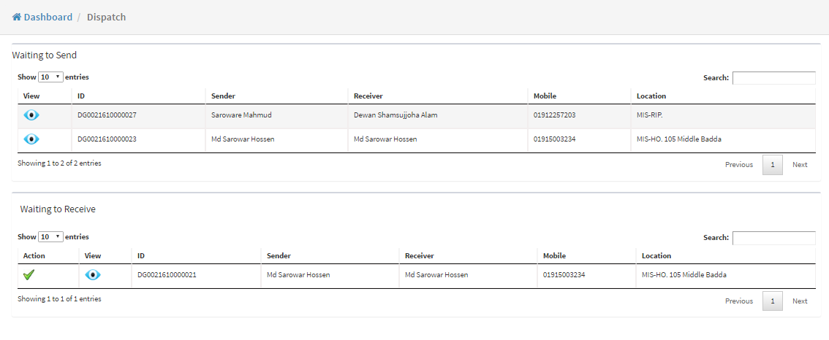
DISPATCH DESK

Slide 9
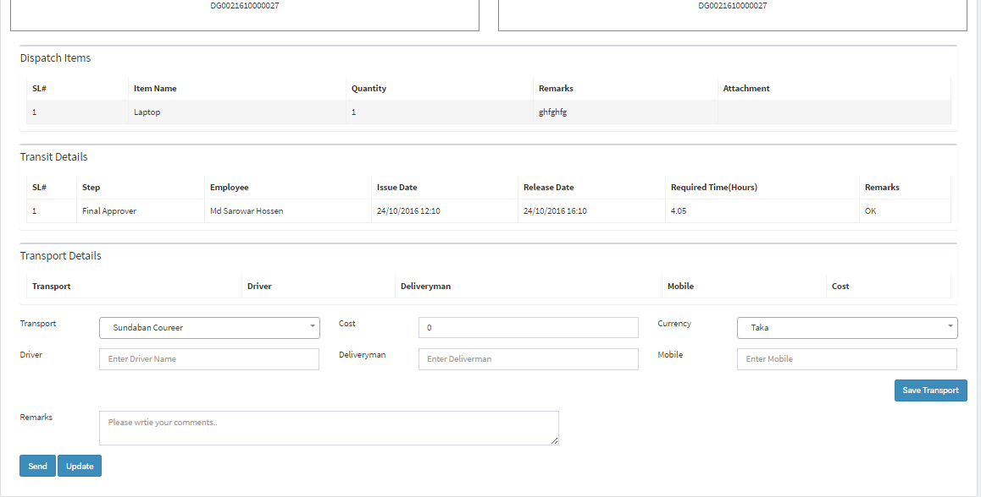
DISPATCH SEND

Slide 10
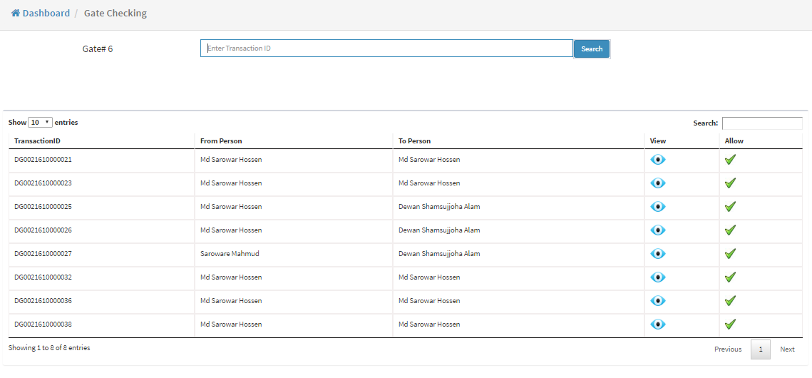
GATE CHECKING

Slide 11
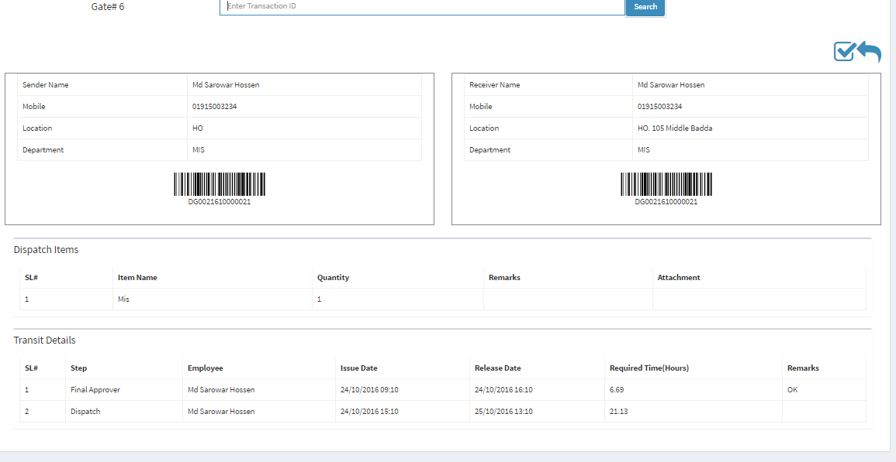
GATE CHECKING

Slide 12
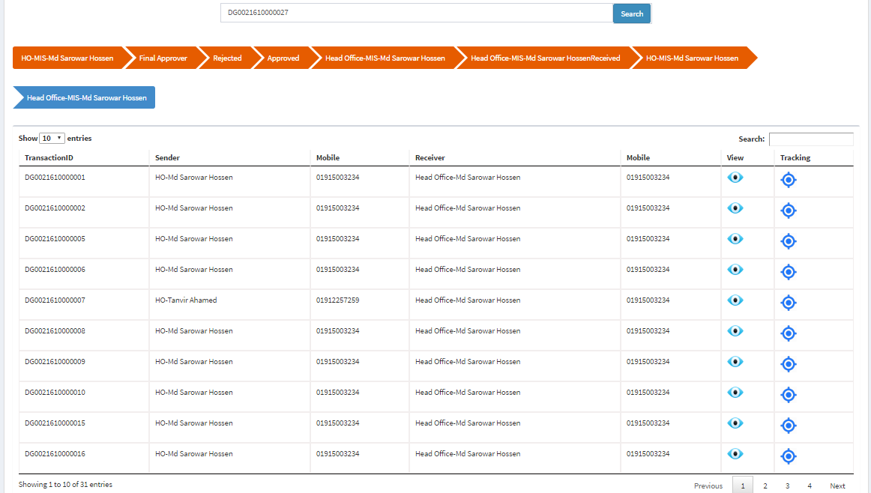
TRACKING

Slide 13
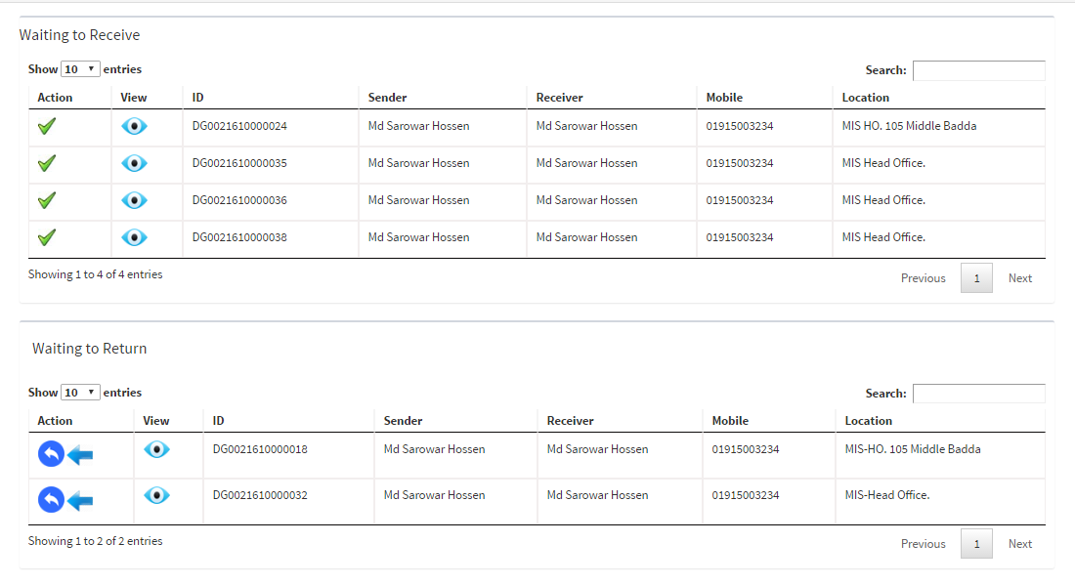
RECEIVE AND RETURN

Slide 14
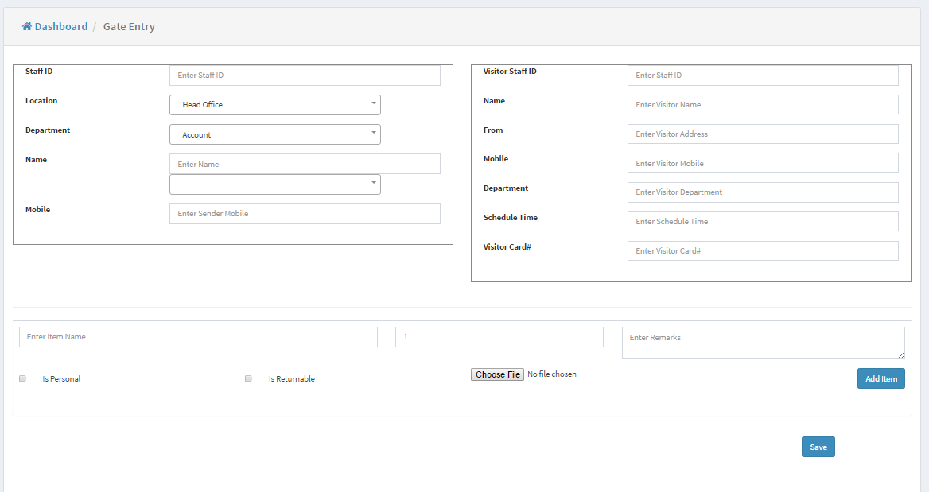
GATE ENTRY

Slide 15
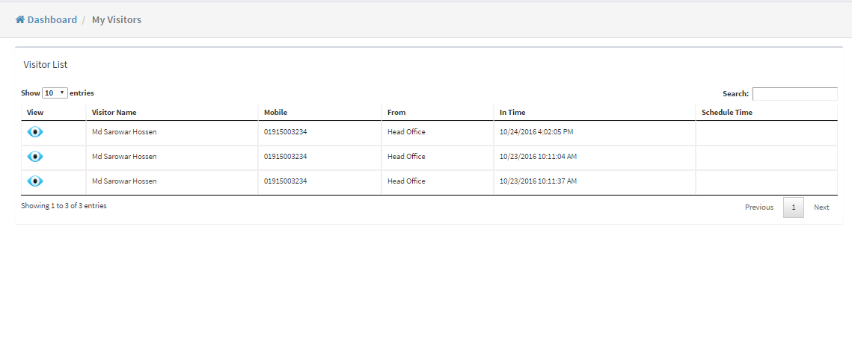
VISITOR LIST

Slide 16
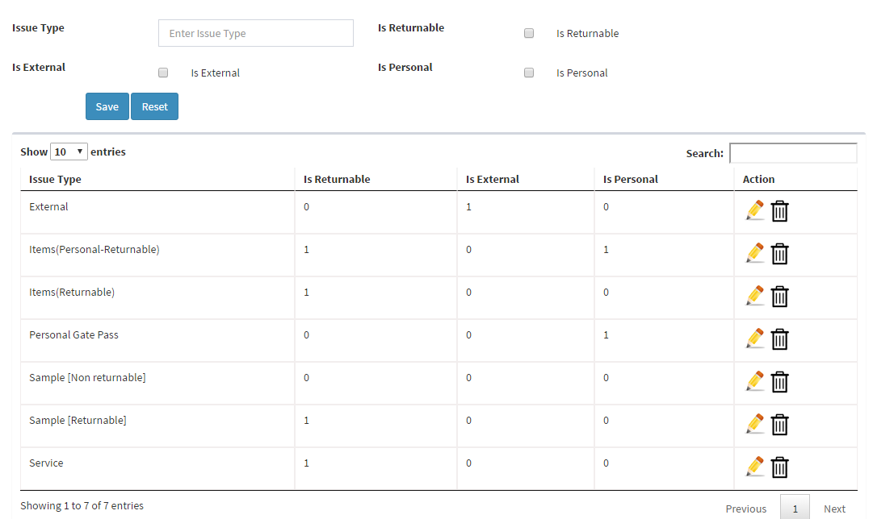
DISPATCH SETTINGS- ISSUE TYPE

Slide 17
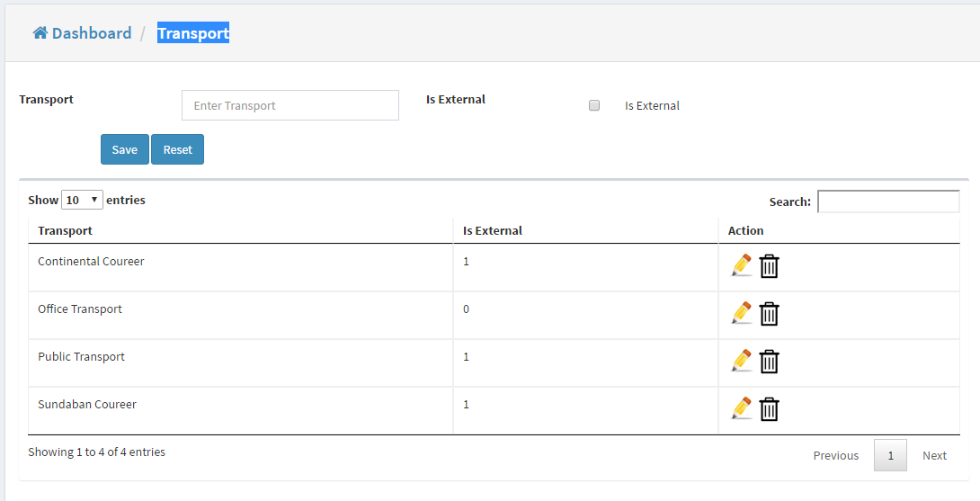
DISPATCH SETTINGS- TRANSPORT

Slide 18
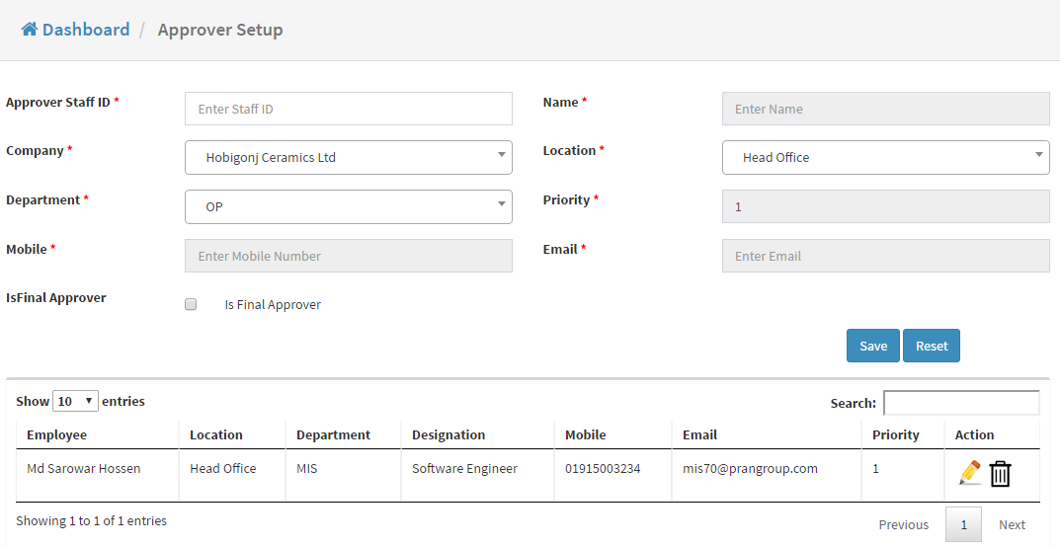
DISPATCH SETTINGS- APPROVER

Slide 19
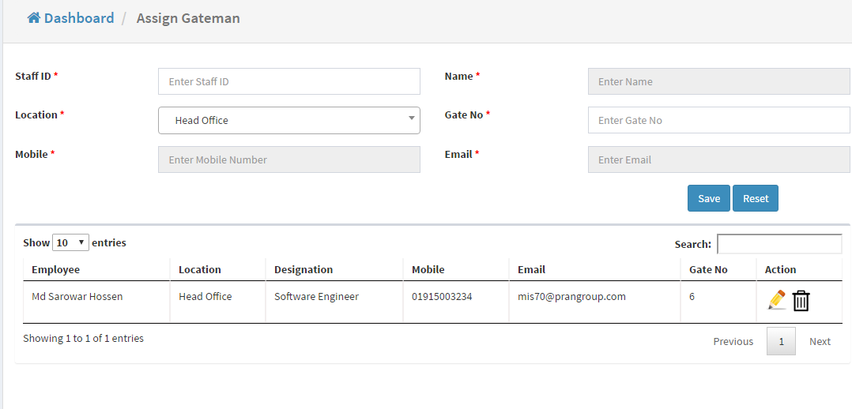
DISPATCH SETTINGS- GATEMAN

